Slide 1

Chapter 15: Data Collection: Enhancing Response Rates while Limiting Errors

Slide 2
Learning Objectives
Describe the 6 types of error that can enter a study
Give the general definition for response rate
Discuss several ways in which response rates might be improved

Slide 3
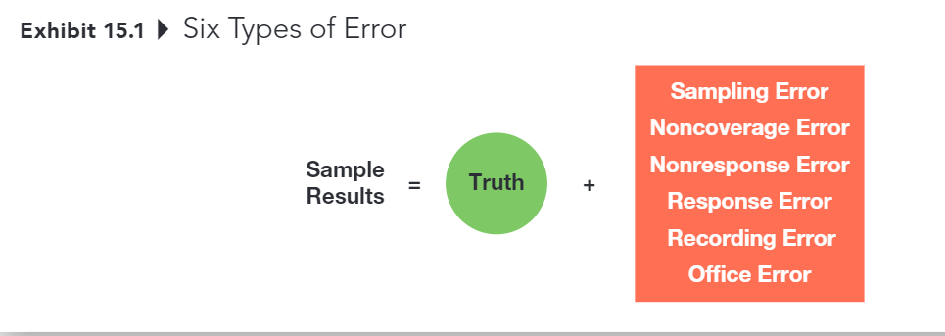
Six Types of Error

Slide 4
Six Types of Error
Sampling Error
The difference between results obtained from a sample and results that would have been obtained had info been gathered from or about every member of the population
Decreased by increasing sample size
Can be estimated (assuming probability sample)
Usually less trouble some than other kinds of error
However, sampling error usually isn’t the biggest problem – it’s all the other things that contribute error to a project.
And these other sources of error can’t be accounted for statistically …

Slide 5
Six Types of Error
Noncoverage Error
Error that arises because of failure to include qualified elements of the defined population in the sampling frame
Noncoverage error is essentially a sampling frame problem

Slide 6
Six Types of Error
Error from failing to obtain info from some elements of the population that were selected and designated for the sample
This is potential problem that only occurs when those who respond are systematically different in some important way from those who don’t respond

Slide 7
Six Types of Error
Suppose that a university wanted to assess the success of its graduates, based on their annual salaries, 5 years after graduation
Which graduates are more likely to return a survey? (Those who are happy with their salaries)
Which graduates are less likely to return a survey? (those who are not happy with their salaries)

Slide 8
Primary Sources of Nonresponse Error
Refusals
Not-at-Homes
Notes:
It’s better to work hard at generating responses from a smaller sampling pool than to start with a much larger sampling pool and ignore potential nonresponse error, even if the resulting sample size is smaller
Pay attention to the response rates delivered by different online panel companies. The completion rate is not the same thing as the overall response rate!

Slide 9
3 Methods for Diagnosing Nonresponse Error
Contact a sample of nonrespondents
Compare respondent demographics against known demographics of population
Conduct an analysis of late responders vs. early responders (this method is very controversial)

Slide 10
Six Types of Error
Response Error
Error that occurs when an individual provides an inaccurate response, consciously or subconsciously, to a survey item
Key considerations:
Does the respondent understand the question?
Does the respondent know the answer to the question?
Is the respondent willing to provide the true answer to the question?
Is the wording of the question or the situation in which it is asked likely to bias the response
Notes:
Source: Weiers (1988)

Slide 11
Six Types of Error
Office Error
Error due to data editing, coding , or analysis errors

Slide 12
Total Error is the Key
The goal is to decrease overall error, not any one source of error
Sampling Error
Noncoverage Error
Nonresponse Error
Response Error
Office

Slide 13
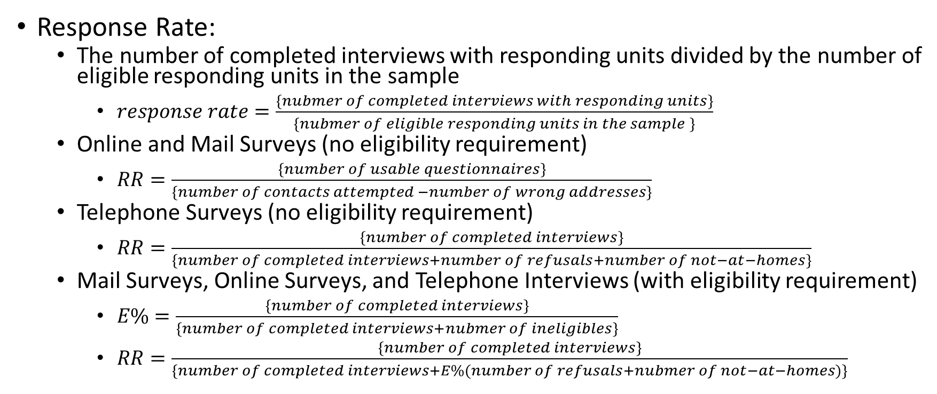
Calculating Response Rates
Response Rate:
The number of completed interviews with responding units divided by the number of eligible responding units in the sample
$response rate=\frac{\left\{nubmer of completed interviews with responding units\right\}}{\left\{nubmer of eligible responding units in the sample \right\}}$
Online and Mail Surveys (no eligibility requirement)
$RR=\frac{\left\{number of usable questionnaires\right\}}{\left\{number of contacts attempted −number of wrong addresses\right\}}$
Telephone Surveys (no eligibility requirement)
$RR=\frac{\left\{number of completed interviews\right\}}{\left\{number of completed interviews+number of refusals+number of not−at−homes\right\}}$
Mail Surveys, Online Surveys, and Telephone Interviews (with eligibility requirement)
$E\%=\frac{\left\{number of completed interviews\right\}}{\left\{number of completed interviews+nubmer of ineligibles\right\}}$
$RR=\frac{\left\{number of completed interviews\right\}}{\left\{number of completed interviews+E\%(number of refusals+nubmer of not−at−homes)\right\}}$

Slide 14
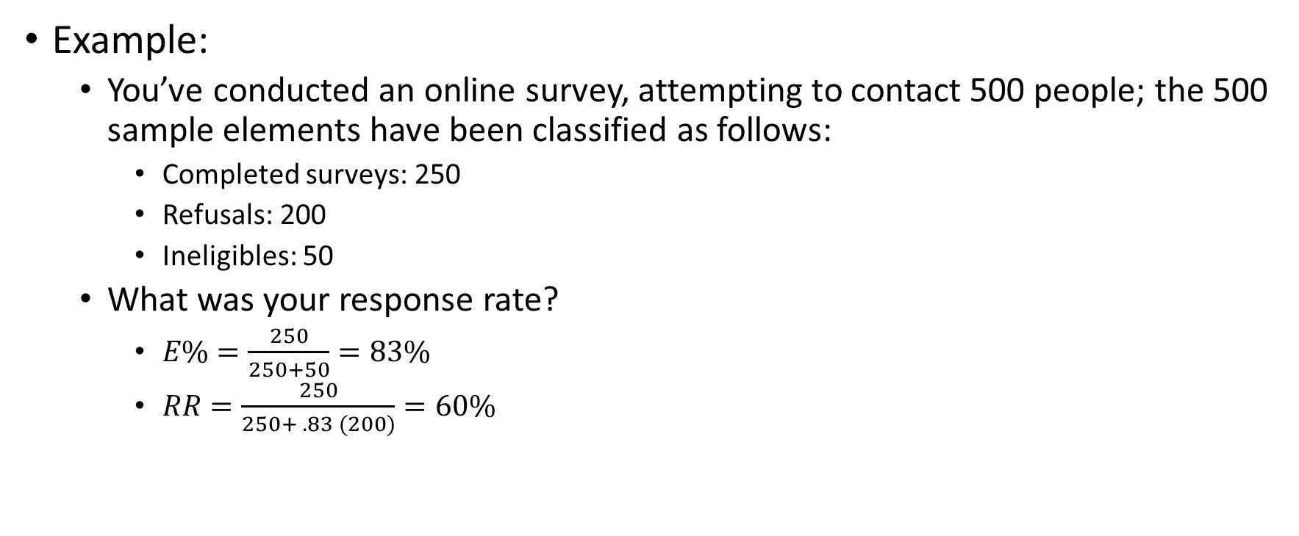
Calculating Response Rates
Example:
You’ve conducted an online survey, attempting to contact 500 people; the 500 sample elements have been classified as follows:
Completed surveys: 250
Refusals: 200
Ineligibles: 50
What was your response rate?
$E\%=\frac{250}{250+50}=83\%$
$RR=\frac{250}{250+ .83 (200)}=60\%$

Slide 15
Improving Response Rates
The response rate on a project serves as an indicator of the overall quality of a data collection effort. It also provides insight into the likely influence of nonresponse error on the project
Researchers must strive to obtain the highest response rates possible in a given situation

Slide 16
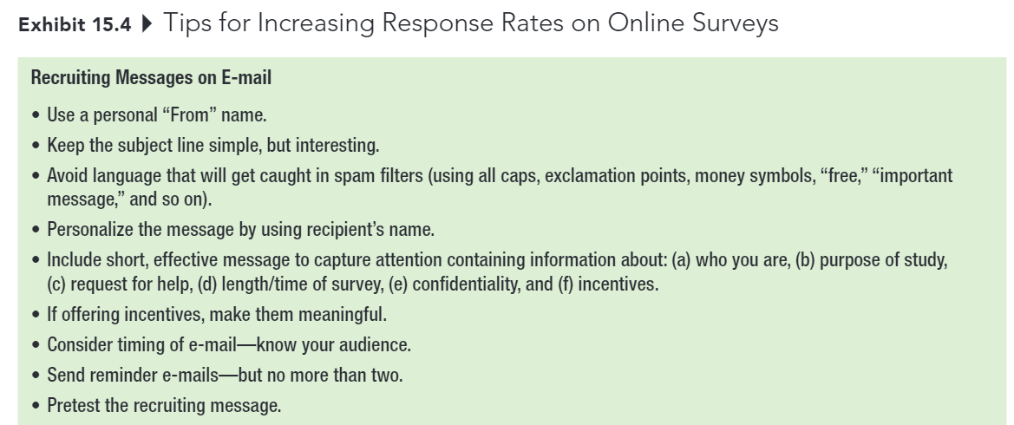
Improving Response Rates

Slide 17
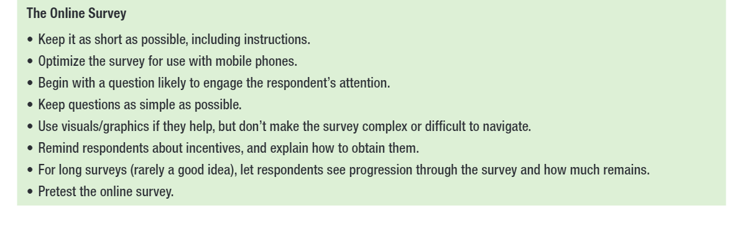
Improving Response Rates

Slide 18
Improving Response Rates
Respondent interest in topic
Survey length
Guarantee of confidentiality or anonymity
Interviewer characteristics and training
Personalization
Response incentives
Follow-up surveys

Slide 19
First Exam
Chapters 8 to 15, with a heavy emphasis on chapters 8, 12, and 15
Please review my slides (especially iClicker questions).
25 questions (200 points) with 2 extra credit questions (16 points) in 75 mins
Notes are allowed
Lockdown Browser is required
1 attempt only
Online
Notes:
You can either take it wherever you want. However, I strongly encourage you to come to class with your laptop to take the exam. I will be in class to answers any questions if you have during the exam. But I can’t answer it if you are elsewhere, so keep it in minds.
It will be open from 7: 55 AM to 9:30 AM on October 11th.

Slide 20
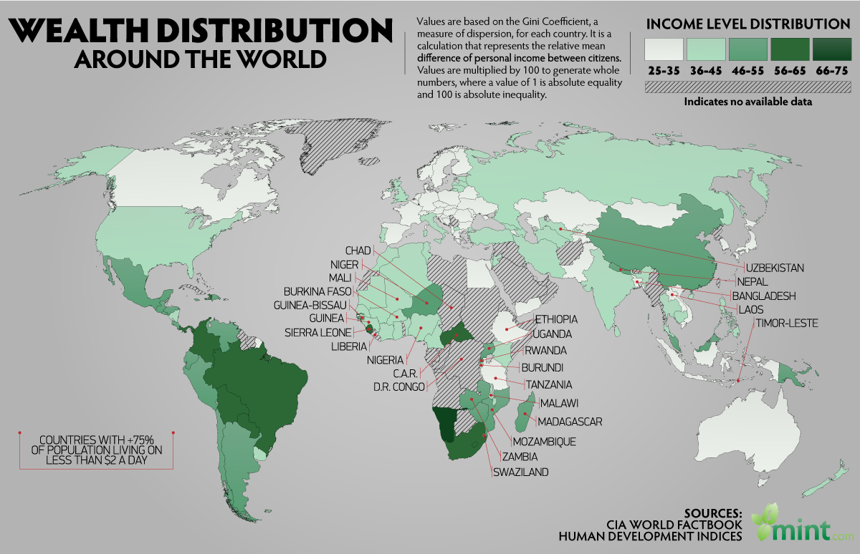
5-min Snippet Wealth Distribution
Pareto Distribution

